Slide 1

Benchmarking Numpy and Breeze
Thanh Trung Nguyen
tnguy404@ucsc.edu
‹#›

Slide 2
Summary
• Numpy (Python) vs Breeze (Scala)
• Application: Principal Component Analysis (PCA) algorithm implemented from scratch
• Input set:
Randomly Generated matrices (and saved as csv files) of different sizes generated based on Normal distribution with mean = 1 and variance = 1
Input size ranging in 2 dimensions: # of features and # of samples:
# of features: 4, 8, 16, 32, 64, 128
# of samples: 1000, 2000, 4000, 8000, 16000, 32000
‹#›

Slide 3
Summary (continue)
• Time: Numpy was in generally faster than Breeze across datasets, especially with small dataset/early steps of large datasets
• Performance metrics:
Numpy has better performance (Lower execution time, higher IPC, lower branch prediction miss rate, lower cache miss rate) in the initial phase
Breeze catches up quickly, has higher performance after initial phase
‹#›

Slide 4
Numpy
• https://github.com/numpy/numpy
• Numerical library for Python
• Written in C
• Supports large, multi-dimensional arrays and matrices
• The base of a lot of other libraries: SciPy, Scikit-learn, Tensorflow, Pytorch, openCV, etc
• Targeted users: Data Scientists, Mathematicians
‹#›

Slide 5
Breeze
• https://github.com/scalanlp/breeze
• Numerical library for Scala
• Written in Scala
• Target: becoming a “Numpy” library for Scala
• Written in Scala so convenient to use with Apache Spark (distributed computing engine) to build ETL to process data in realtime/large scale
• Targeted users: Data Engineers
‹#›

Slide 6
Application
• Principal Component Analysis: Removing highly dependent features to avoid overfitting in Machine Learning
• I.e.: running ML algorithm on a housing dataset: House price feature and Annual property tax feature is highly dependent
=> PCA can automatically remove one of them
• I implemented this algorithm from scratch
‹#›

Slide 7
Application Structure
• Read csv dataset and create the dataset matrix
• Arithmetic computations:
Compute the d-dimensional mean vector
Compute the covariance matrix
Compute eigenvectors (e_1, e_2,..., e_d) and corresponding eigenvalues (λ_1, λ_2,..., λ_d)
Sort the eigenvectors by decreasing eigenvalues, choose k eigenvectors with the largest eigenvalues
Use this d*k eigenvector matrix to transform the samples onto the new subspace
• Write the result to a csv file
‹#›

Slide 8
Input sets
• csv files of different sizes
• Data randomly created from a normal distribution with mean = 1 and variance = 1
• Number of features (dimensions): 4, 8, 16, 32, 64, 128
• Number of samples: 1000, 2000, 4000, 8000, 16000, 32000
‹#›

Slide 9
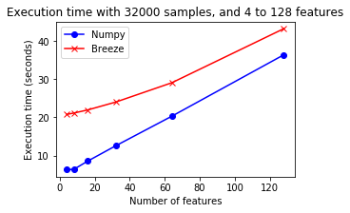
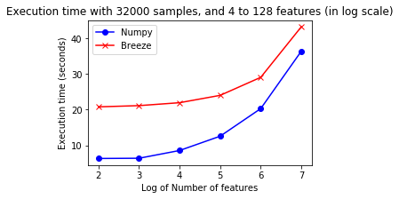
Execution Time
# samples = 32000, different feature sizes:
‹#›

Slide 10
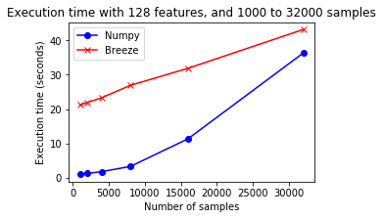
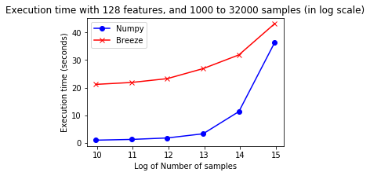
Execution Time
# features = 128, different sample sizes:
‹#›

Slide 11
Execution Time Plot Analysis
• Breeze was a lot slower than Numpy with small datasets (for 4 features, 1000 samples: Breeze took ~20 seconds, Numpy took ~1 second)
• Breeze catched up quickly with bigger datasets
• The execution time is as my expectation:
Since the dataset size is doubled every time, I expect the runtime increases with exponential rate
Therefore the plot with respect to log(# of features/samples) of run time should be exponential and plot wrt # of features/samples should be linear (which is true)
‹#›

Slide 12
Dataset Limit
It would be interesting to see if Breeze can exceed Python’s runtime performance with a bigger dataset, however:
• Python could process dataset of upto 512 dimensions and 32000 samples
• Scala could not process dataset of 256 dimensions and 32000 samples and up (Java heap space problem)
=> I wasn’t able to run Scala on a bigger dataset
‹#›

Slide 13
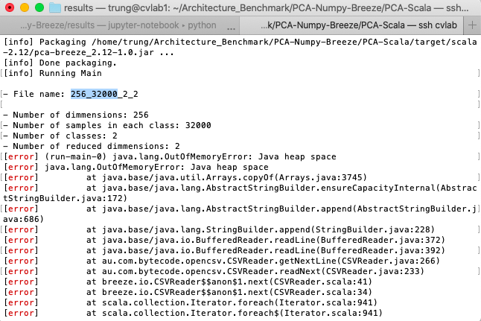
Dataset Limit
‹#›

Slide 14
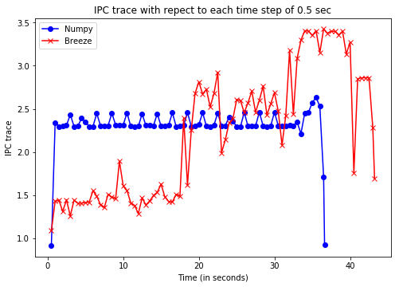
IPC
Note: The IPC and all the MPKI plots correspond to the biggest dataset with 32000 samples and 128 features
‹#›

Slide 15
IPC Plot Analysis
• Breeze’s IPC was lower than Numpy in the first 20 seconds, higher in the later 20 seconds
• This corresponds correctly to the Execution Time plot above: even with a small dataset, Breeze took ~20 seconds to process
=> Up on investigation, I reason this as Scala runs on JVM which initializes needed classes and the classes must be loaded when they are used
=> Take much more time than C/C++ initially
‹#›

Slide 16
IPC Plot Analysis (Continue)
• Breeze’s IPC fluctuated quite a lot
• Numpy’s IPC was stable, except in the beginning and at the end
=> This may be due to the program’s structure: In the beginning it has to load the csv dataset (fluctuate phase), then process using mostly arithmetic computations (stable phase), and then save the result to a csv file (fluctuate phase)
‹#›

Slide 17
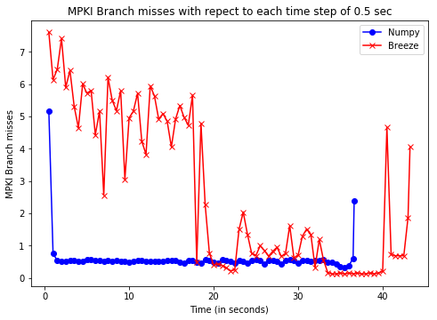
Branch Prediction (MPKI)
‹#›

Slide 18
Branch Prediction (MPKI) Analysis
• This looks reasonable: Prediction miss rates are only ~ 0-8 instructions for every 1024 instructions
• Numpy has an overall better branch prediction rate
• Both has higher miss rates at begin phase (for Numpy: first 1 second, for Scala: first 20 seconds) and end phase, and lower at the computation phase
‹#›

Slide 19
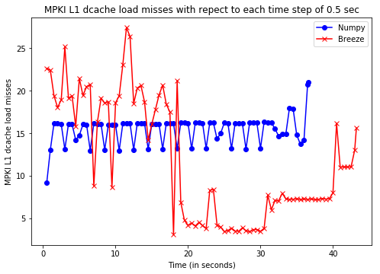
L1 d-cache misses (MPKI)
‹#›

Slide 20
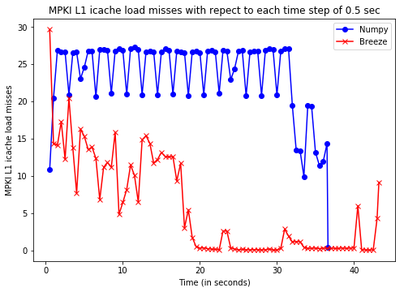
L1 i-cache misses (MPKI)
‹#›

Slide 21
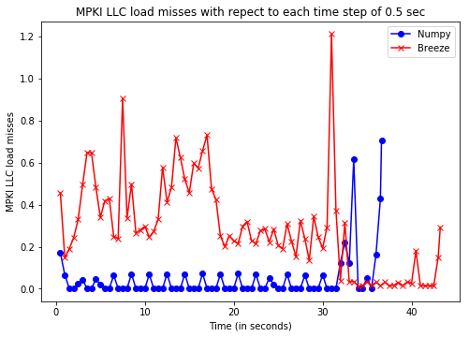
LLC load misses (MPKI)
‹#›

Slide 22
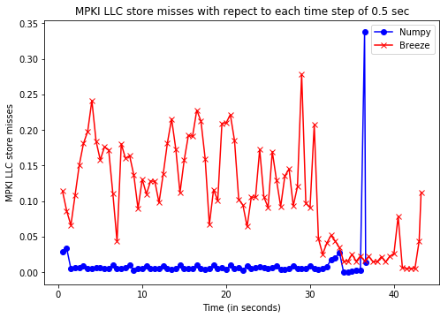
LLC store misses (MPKI)
‹#›

Slide 23
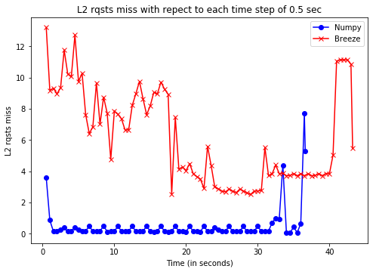
L2 rqsts misses (MPKI)
‹#›

Slide 24
Cache misses (MPKI) Analysis
• Breeze has higher L1 d-cache miss rates in the initial phase (first 20 seconds), but lower L1 Cache Miss Rates than Numpy after that.
=> This is in accordance with the previous Execution Time and IPC plots
• Numpy has lower L2 cache miss rates across runtime
‹#›

Slide 25
Main observations, Conclusions
• Numpy’s performance was quite consistent
• Breeze’s performance was worse that Numpy in the initial phase, but got better after that
• Why Numpy was faster than Breeze in the early steps?
Numpy is not written in Python but C, so could achieve a really good speed
Breeze is Scala-based so runs on JVM. Therefore it initializes needed classes and the classes must be loaded when they are used => The start-up time of a Scala program is often longer than C/C++
‹#›

Slide 26
How to Reproduce results
Generate input csv files:
• Run file data_generator.py
• It creates csv files with sizes
• Number of features: ranging from 4 to 512
• Number of samples: ranging from 1000 to 128000
• To modify number of maximum features: edit line 7 of data_generator.py
• To modify number of maximum data lines: edit line 10 of data_generator.py
‹#›

Slide 27
How to Reproduce results (continue)
• Run the Python Numpy application:
$ python PCA-Numpy-Breeze/PCA-Python.py
• Run the Scala Breeze application:
$ cd PCA-Numpy-Breeze/PCA-Scala/
$ sbt run
‹#›

Slide 28
CPU Information
CV Lab’s CPU
processor : 5
vendor_id : GenuineIntel
cpu family : 6
model : 85
model name : Intel(R) Xeon(R) Bronze 3106 CPU @ 1.70GHz
stepping : 4
microcode : 0x2000064
cpu MHz : 800.169
cache size : 11264 KB
physical id : 0
siblings : 8
core id : 5
cpu cores : 8
apicid : 10
initial apicid : 10
fpu : yes
fpu_exception : yes
cpuid level : 22
wp : yes
‹#›

